Slide 1
Covid-19 Community Vaccination
Awareness Initiative (CCVAI)

Slide 2
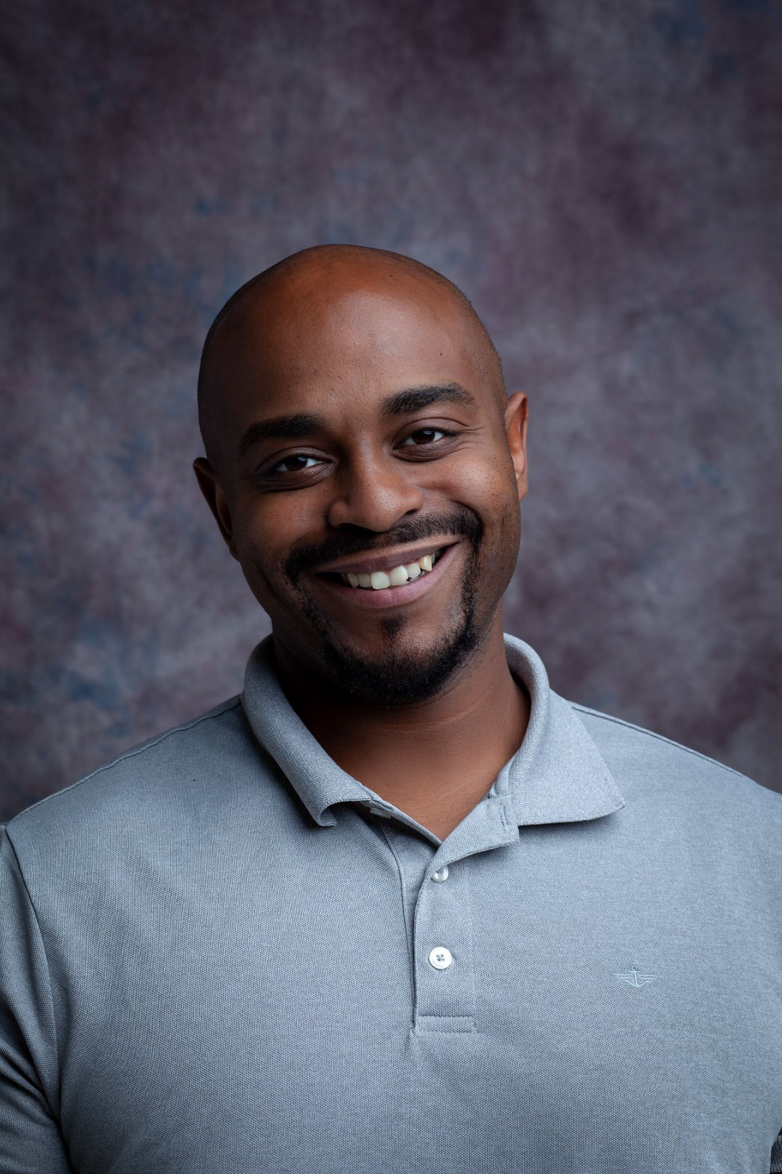
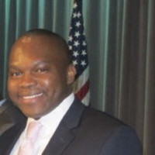
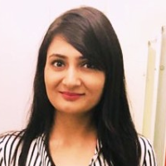

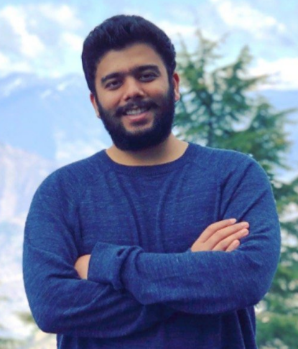
Our Team
Cameron Clark, Project Manager
Adrian Richards, Team Member
Saumya Agrawal, Team Member
Sherisse Joseph, Team Member
Vallabh Sawant, Team Member

Slide 3
Project Charter
Project Manager Responsibilities:
Time management
Monitor weekly Progress
Coordinate team project activities
Motivate team members
Conflict resolution
Project Objectives: (Define SMART objectives)
Receive 80% of target funding from Angel Investors by 28th April,2021.
Start a non-profit organization to educate underserved communities about covid vaccines in New Jersey.
Educate up to 110,000 underserved communities in New Jersey in 3 different phases.
Help 70% of campaign attendees be vaccinated within 3 months post-education during phases 1,2 and 3.
Success Criteria: (How to measure if the project was successful)
60%-80% funding commitment by April 28
Completion of CCVAI project plan and presentation
Risks: Describe the main risks already known at this stage
Resistance from underserved communities
Religious beliefs
Political Influence
Language barrier
Lack of funding
Unable to reach the target people

Slide 4
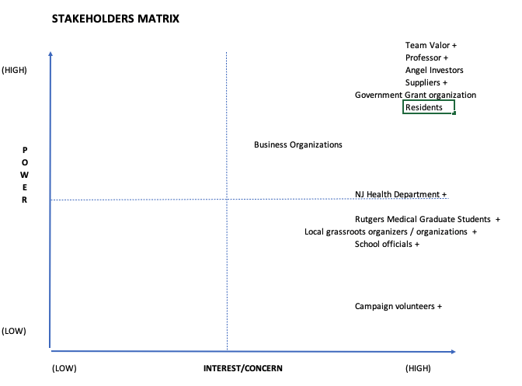
Stakeholders Matrix
Stakeholders
Name | +/ - / Neutral
Professor | +
Health Department | +
Angel Investors | Neutral
Suppliers | +
Target Audience | Neutral

Slide 5
Requirements
Stakeholder Name | Requirement
Professor | Develop project plan for non-profit organization by April 28, 2021 Teams to develop project charter in line with primary requirement
Suppliers (Vaccine Companies) | NJ non-profit to provide total # of participants attending in person sessions or webinars related to COVID-19 vaccines quarterly Secure partnership with non-profit organization in New Jersey in first half of 2021

Slide 6
Scope of Product
G. Investors/Fundraising:
G8: Plan to visit at least 3-5 NJ local non-profit organizations to seek grants.
We are seeking grants from the New Jersey state government to organize the campaign in their city. As per our research, New Jersey is giving aid to a number of NJ businesses and nonprofits, along with business guidance, to help with COVID-19 relief and recovery.
G9: Reach out to 2-3 COVID-19 relief organizations to seek grants.
Nonprofit organizations serving New Jersey state through work with communities who are disproportionately impacted by COVID-19
G11: Provide 100% information on safety protocols and permissions obtained for the campaign to be eligible for grants.
The New Jersey state government will review the budget, permissions and agreements related to the campaign.
G12: COVID grants organizations should be 100% convinced about the COVID-related help to the community in order to be eligible for grants.
The New Jersey state government will gauge how our campaign will be able to help minimize the impact on COVID in New Jersey state.

Slide 7
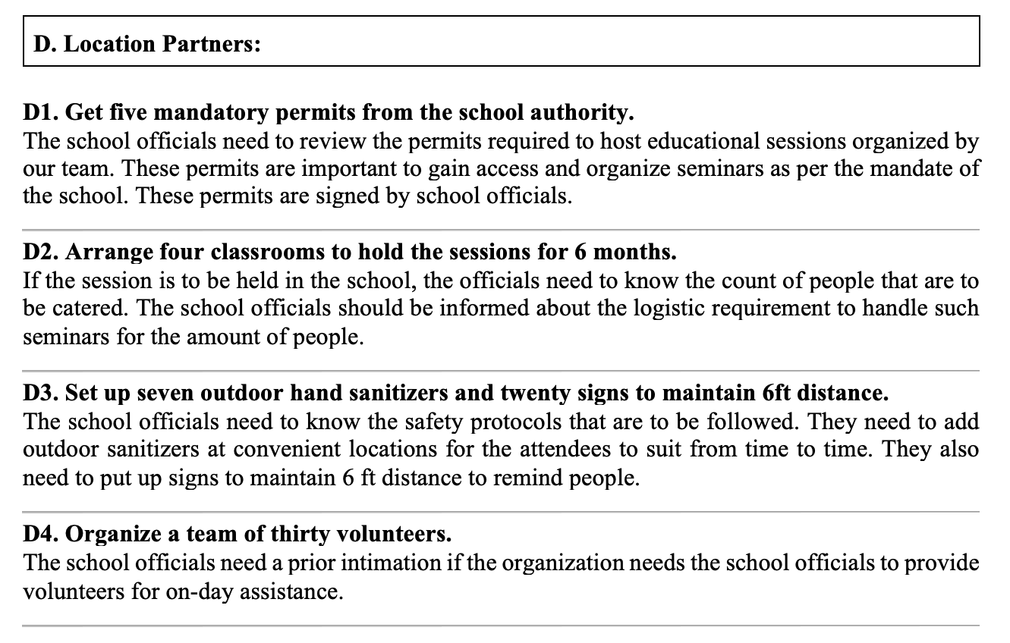
Scope of Product

Slide 8
Scope of Project
This project seeks to aid underserved communities who have been the hardest impacted by the recent pandemic.
Our purpose is to assist in educating our target audience by enabling them to utilize available avenues that secure a healthy path forward via the newly developed vaccination program.
Together with trusted community leaders, our project will help our clients in researching facts about available vaccinations, one's eligibility, and securing an appointment.
Out of Scope:
Our program will not be administering vaccinations to clients, providing any other medical services, advice, or compensation.

Slide 9
Scope of Project
3.2 Pitch business plan
After researching all possible areas of interests and money needed, we need to jot down points that would entice the angel investors to sponsor the initiative. A good presentation needs to be created with all the required information that needs to be presented.
The team should arrive on the scheduled time, dress formally and present it to the angel investors.
3.3 Outcome
After the presentation is over, the angel investors will come up with a decision. The team should consider all the feedback from the angel investors. The project manager can also put forward some improvements based on the suggestions from the angel investors. Finally, the angel investors will then decide to sponsor our initiative if they seem convinced by our presentation and our initiative. This outcome will decide the progress of the project.

Slide 10
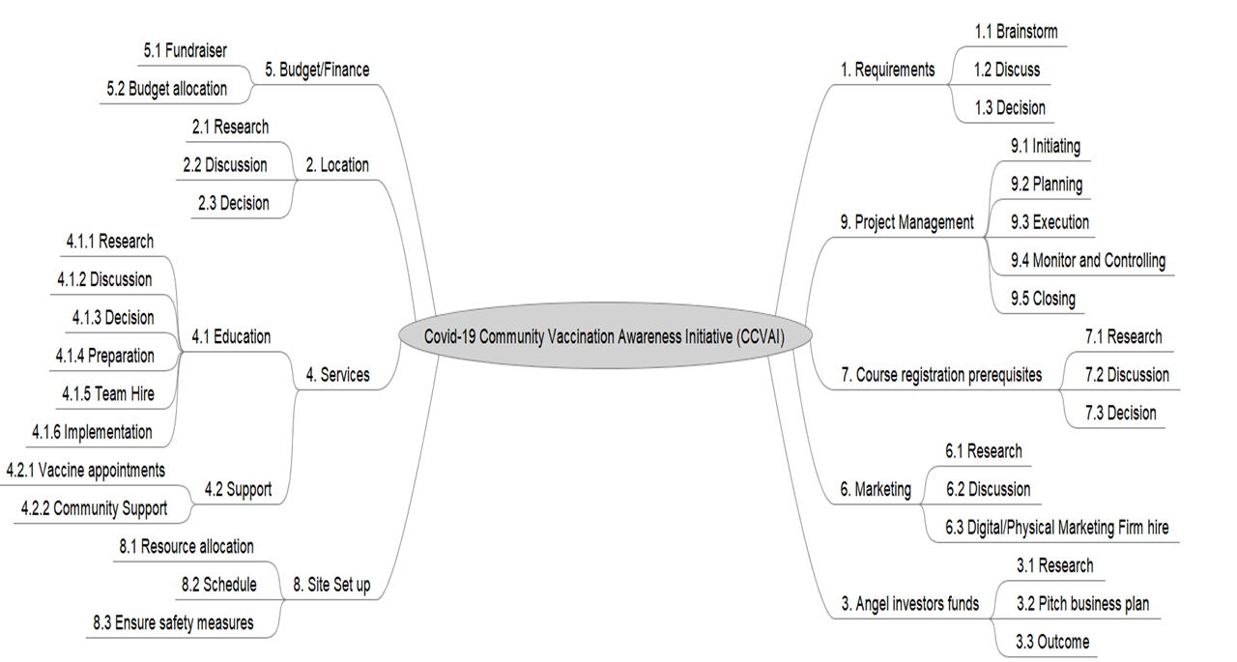
WBS

Slide 11
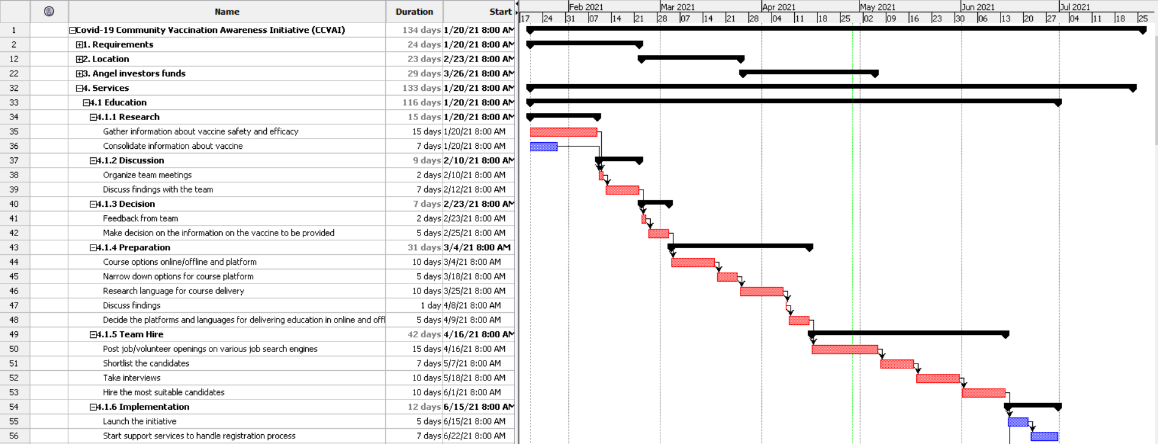
WBS Schedule

Slide 12
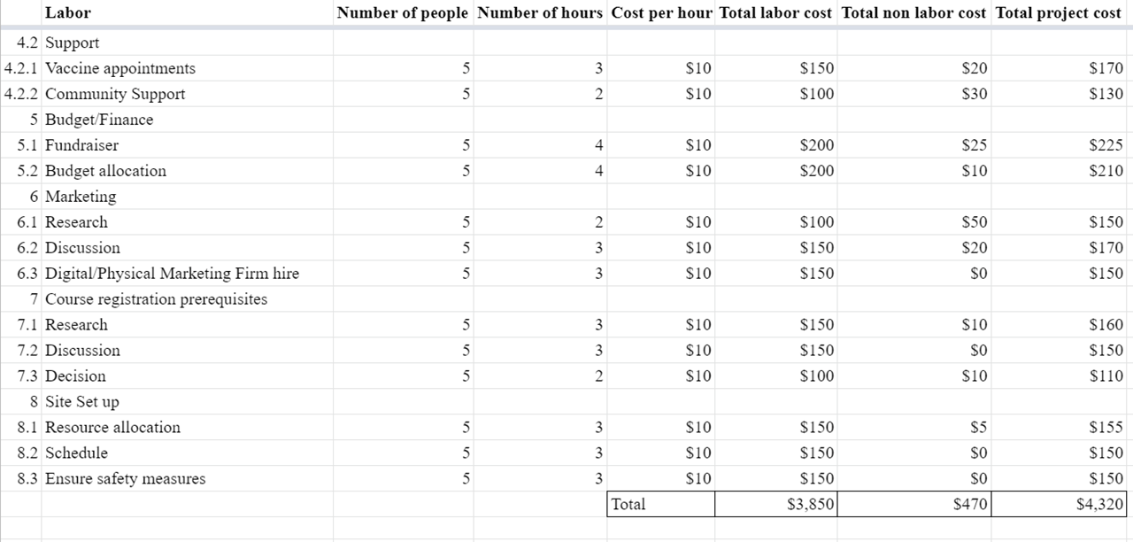
Cost Estimate

Slide 13
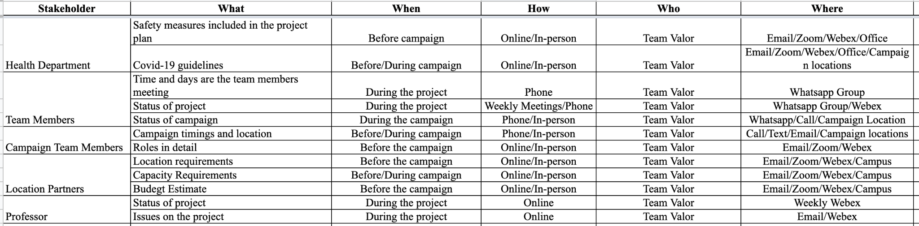
Communications Plan

Slide 14
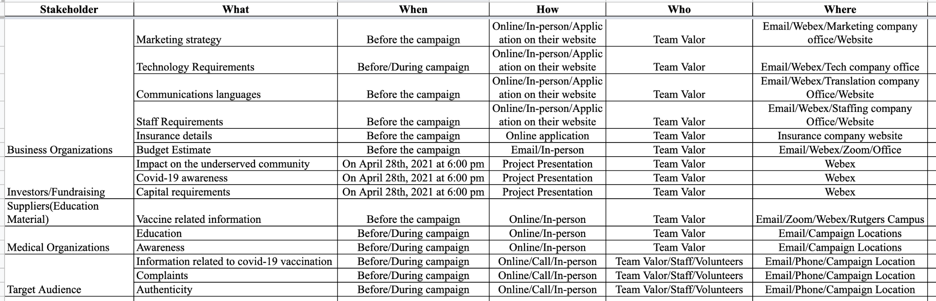
Communications Plan

Slide 15
Risk Probability/Impact
Risk List | Probability (1-5) | Impact (1-5) | Severity (P*I) | Action Plan | Contingency Plan
Vaccine hesitancy/ Side effects | 4 | 4 | 16 | Mitigate: Educate people about all different vaccines. Compare the benefits vs side effects. Make them understand that the probability of a person having life threatening side effects is very less. | If the person does face life threatening side effects, admit the person to a hospital. Ask the government/ insurance or the vaccine companies to take care of the expenses.
Religious beliefs | 4 | 3 | 12 | Mitigate: Try to make the person understand that life is more important than religion. | Accept their beliefs and move on.
Personal conceptions | 3 | 4 | 12 | Mitigate: Don’t let the person develop a negative perspective about the vaccine. Convince the person to attend the seminar, explain the benefits of vaccination and clear all their misconceptions. | If a negative perspective is developed, ask a family member, close friend or relative to make the person understand the benefits as they could be more influential.

Slide 16
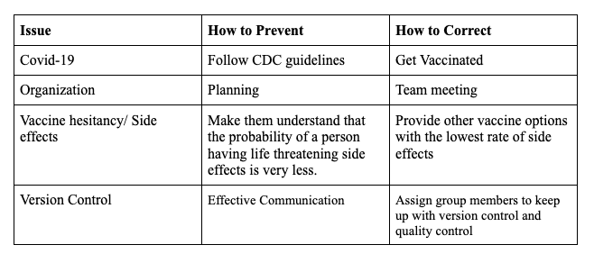
Issue log

Slide 17
Change Request
Date Request Submitted | Title of Change Request | Change Order Number | Description of change requested | Impact of proposed change | Approvers & Date
1/27/2021 | Minimum Page Requirements for Scope Statement | 001 | Length of scope statement page count initially undefined. However, Professor Herszon clarified that the minimum amount is 20 pages. | 1) Risk: Medium 2) Schedule: 1.5 hours of work 3) Cost $75 | Cameron Clark (2/08/2021) Prof. Herszon / Client (2/10/2021)

Slide 18
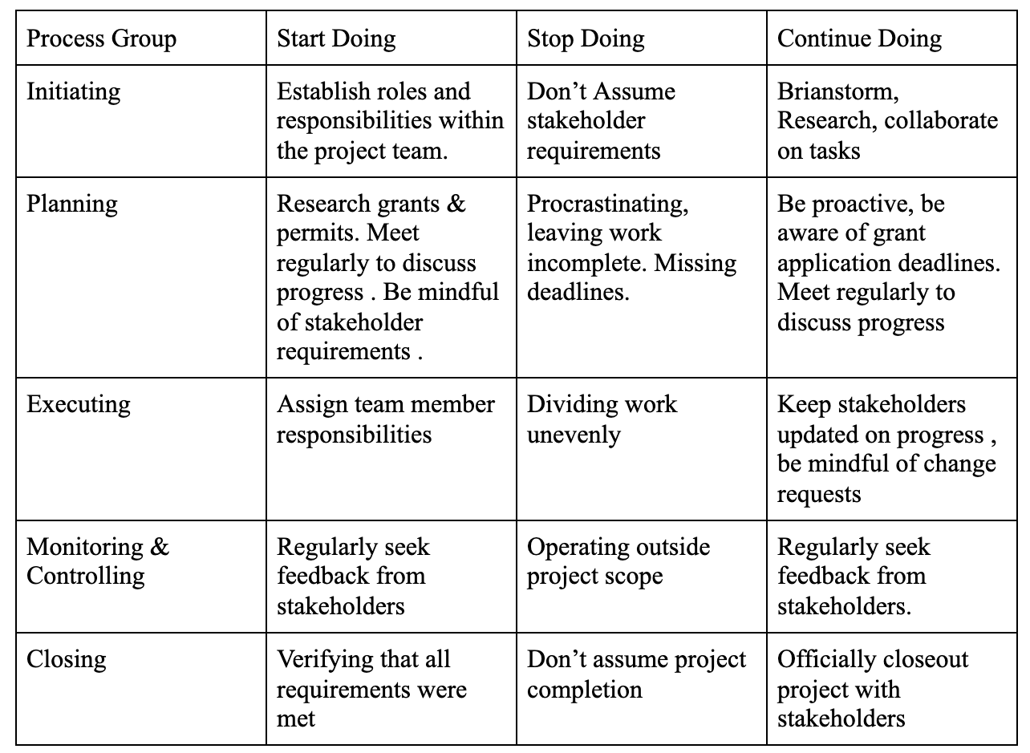
Lessons Learned

Slide 19
Conclusion / Questions

